Slide 1
Unit V
Logic Families

Slide 2
Logic Families
Complex digital functions can be realized using basic electronic components in variety of forms and each form is called as a Logic family.
Electronic components: Diode, Transistors,
MOSFETS etc.

Slide 3
Logic Families
The set of compatible ICs with the same logic levels and same supply voltage fabricated to perform the various logic functions is called logic family.

Slide 4
Logic Families - Classification
Bipolar Logic Families
Saturated Bipolar Logic Families
Unsaturated Bipolar Logic Families
Unipolar Logic Families
PMOS
NMOS
CMOS

Slide 5
Logic Families - Classification
Bipolar Logic Families
Saturated Bipolar Logic Families
Transistors operate in saturation region – less speed
Unsaturated Bipolar Logic Families
Transistors operate in Active region – more speed

Slide 6
Logic Families - Classification
Bipolar Logic Families
Saturated Bipolar Logic Families
RTL – Resistor Transistor Logic
DCTL – Direct Coupled Transistor Logic
IIL – Integrated Injection Logic
DTL- Diode Transistor Logic
HTL – High Threshold Logic
TTL – Transistor Transistor Logic

Slide 7
Logic Families - Classification
Bipolar Logic Families
Unsaturated Bipolar Logic Families
STTL – Schottky Transistor Transistor Logic
Emitter Coupled Logic

Slide 8
Characteristics of Digital ICs
Speed of Operation
Power Dissipation
Figure of Merit
Fan Out
Fan In
Current and Voltage Parameters
Noise Immunity
Power Supply Requirements
Operating Temperature

Slide 9
Characteristics of Digital ICs
Speed of Operation
Power Dissipation
Figure of Merit
Fan Out
Fan In
Current and Voltage Parameters
Noise Immunity
Power Supply Requirements
Operating Temperature

Slide 10
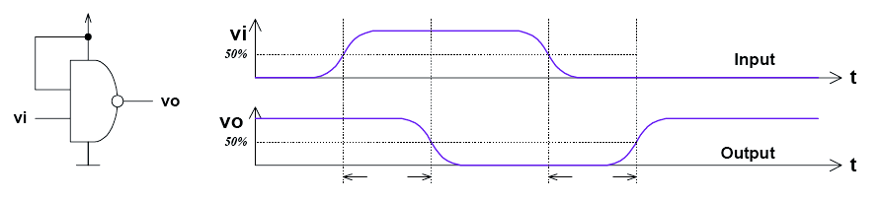
Characteristics of Digital ICs
Speed of Operation/ Propagation Delay time
TPD,HL–input-to-output propagation delay from HI to LO output TPD,LH–input-to-output propagation delay from LO to HI output
Propagation delay is average of TPD, HL and TPD, LH

Slide 11
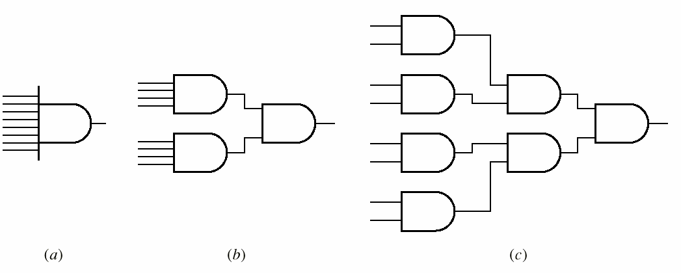
Characteristics of Digital ICs Propagation Delay

Slide 12
Characteristics of Digital ICs
Propagation Delay - Causes
Time to switch the transistor
Time to charge or discharge the load capacitance

Slide 13
Characteristics of Digital ICs
Power Dissipation
It is wastage of power across the circuit components.
It should be as low as possible.
It is measured in milliwatts

Slide 14
Characteristics of Digital ICs
Figure of Merit
Figure of Merit = Propagation Delay (ns) * Power Dissipation (mw) in pj
ns – nano seconds
mw – milliwatts
pj – pico joules
Speed-power product: TPD ×Pavg

Slide 15
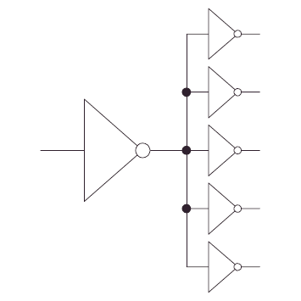
Characteristics of Digital ICs
Fan Out
It is capability of a logic gate to drive maximum no. of similar gates.
High fan out is desirable

Slide 16
Characteristics of Digital ICs
Fan In
It is total no. of inputs connected to any gate.
Two input gate – Fan in =2
Four input gate – Fan in =4

Slide 17
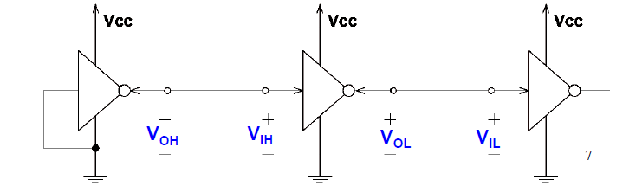
Characteristics of Digital ICs
Voltage Parameters
VOH(min) –The minimum voltage level at an output in the logical “1” state under defined load conditions
VOL(max) –The maximum voltage level at an output in the logical “0” state under defined load conditions
VIH(min) –The minimum voltage required at an input to be recognized as “1” logical state
VIL(max) –The maximum voltage required at an input that still will be recognized as “0” logical state

Slide 18
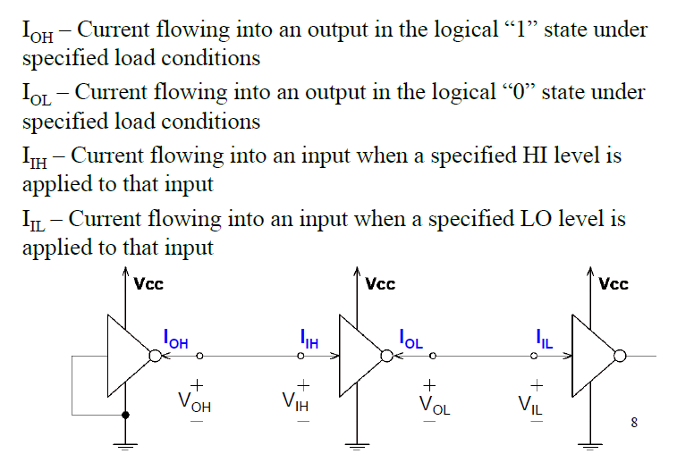
Characteristics of Digital ICs – Current Parameters

Slide 19
Characteristics of Digital ICs
Noise Immunity
The unwanted signal is noise and effect is additive always.
Ability of the circuit to tolerate noise signal is called noise immunity.
Quantitative measure of noise immunity is called noise margin.

Slide 20
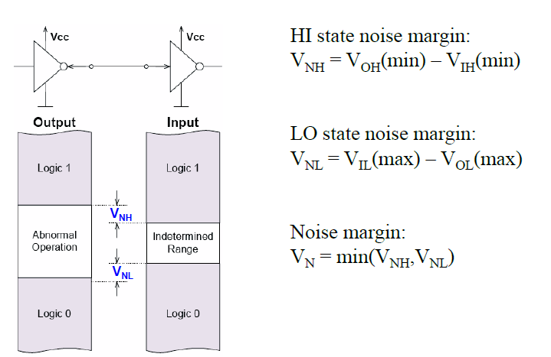
Characteristics of Digital ICs
Noise Immunity

Slide 21
Characteristics of Digital ICs
Power Supply Requirements
The required power requirement for the logic family
Should be as minimum as possible

Slide 22
Characteristics of Digital ICs
Operating Temperature
-55 C to +125 C – Military and space applications
0 C to+70C – Commercial and Industrial Applications.

Slide 23
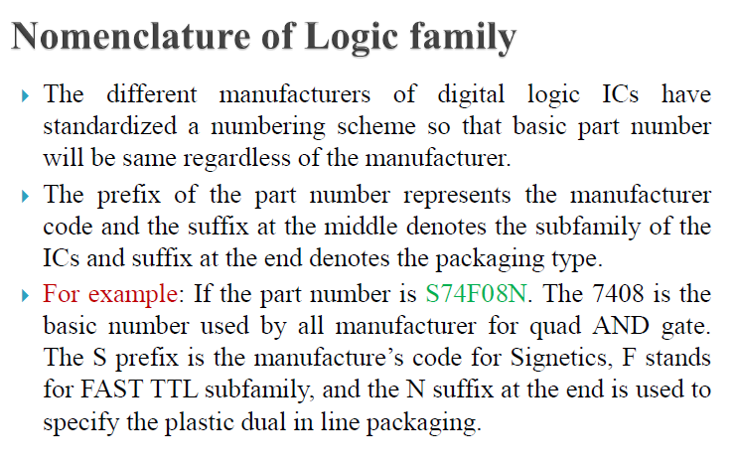
Logic Families

Slide 24
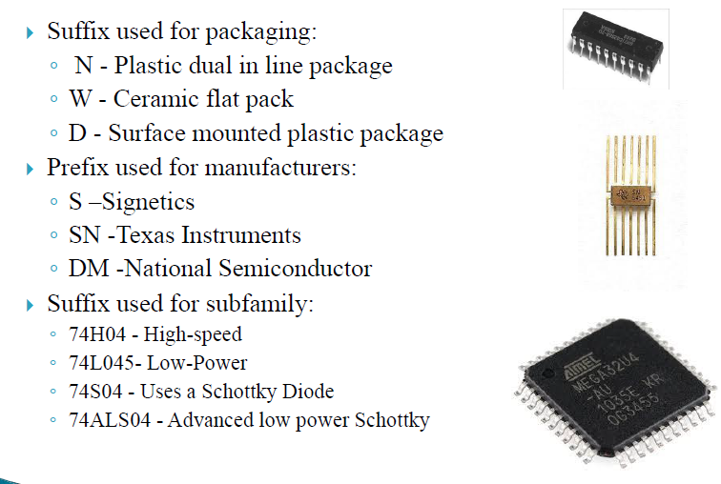
Logic Families

Slide 25
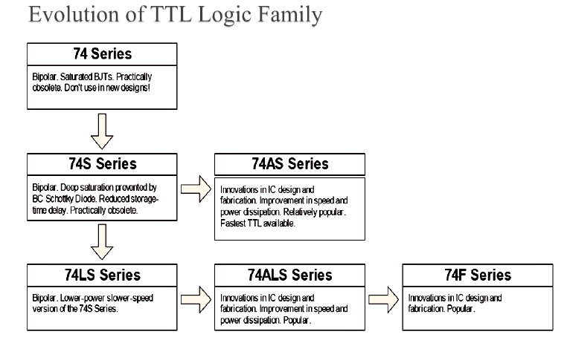

Slide 26
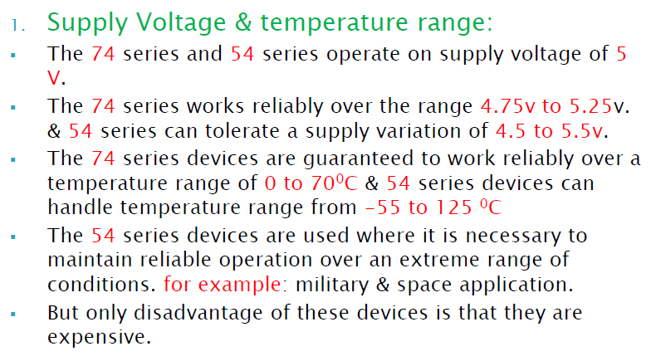
Standard TTL Characteristics

Slide 27
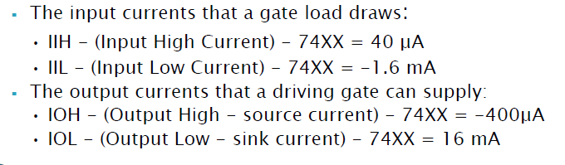
TTL - Input and Output Current

Slide 28
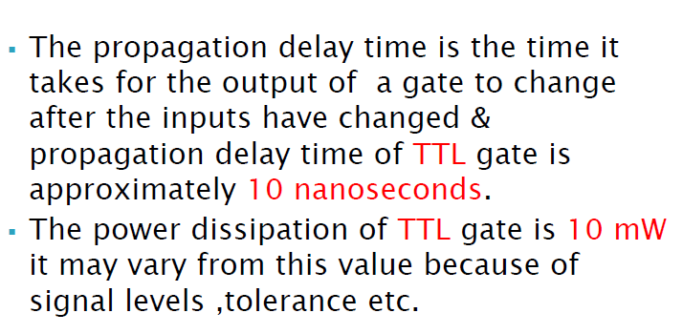
Propagation Delay and Power Dissipation

Slide 29
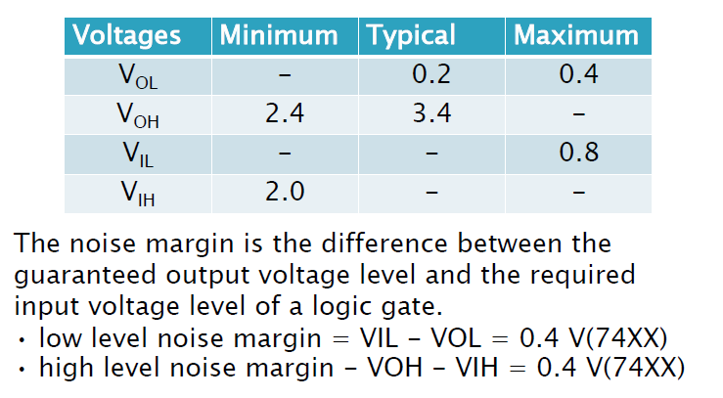
Voltage Levels and Noise Margins

Slide 30
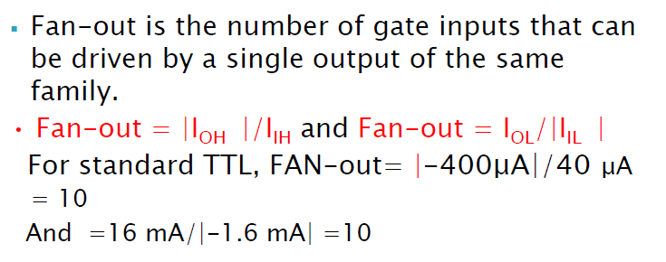
Fan Out

Slide 31
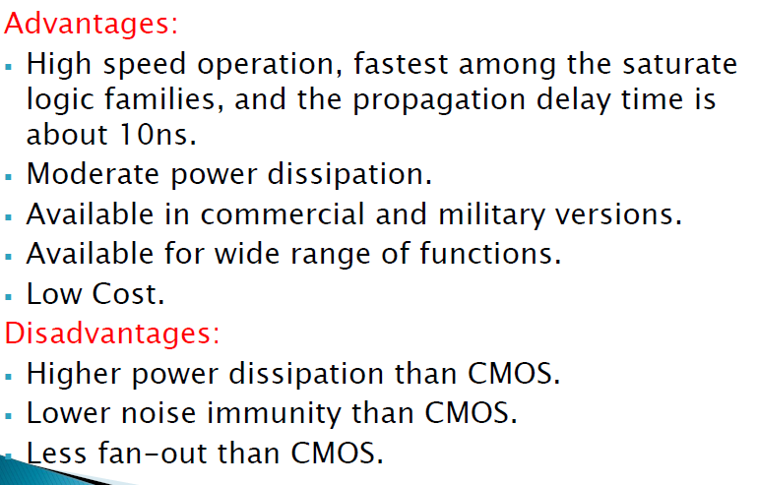
Advantages and Disadvantages of TTL

Slide 32
TTL – Transistor Transistor Logic
Saturated Logic Family …..(Saturation/Cutoff)
Standard TTL………(First Version)
TTL with Passive pullup
TTL with Totem Pole output
TTL with open collector output
Tristate TTL
Newer TTL families still used (74AL00 …)
Distinct Features: Multi Emitter Transistors

Slide 33
TTL (Contd..)
Transistor representation of NAND gate
VL
A.B
A
B

Slide 34
TTL (Contd..)
NOR gate in Transistor layer
VL
A+B
A
B

Slide 35
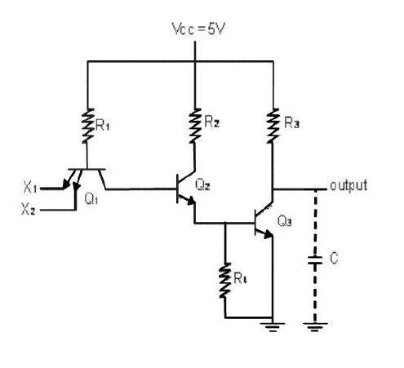
2 Input TTL NAND Gate with Passive Pull-up
Inputs |  | Transistor Q1 |  | Transistors Q2 and Q3 | Output
X1 | X2 | Emitter Junction X1 | Emitter Junction X2
0 | 0 | FB | FB | CUT OFF | 1
0 | 1 | FB | RB | CUT OFF | 1
1 | 0 | RB | FB | CUT OFF | 1
1 | 1 | RB | RB | SATURATION | 0

Slide 36
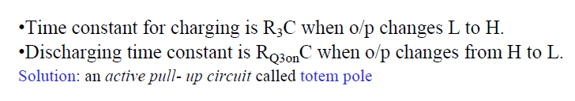
2 Input TTL NAND Gate with Passive Pull-up

Slide 37
TTL – Transistor Transistor Logic
Saturated Logic Family …..(Saturation/Cutoff)
Standard TTL………(First Version)
TTL with Passive pullup
TTL with Totem Pole output
TTL with open collector output
Tristate TTL
Newer TTL families still used (74AL00 …)
Distinct Features: Multi Emitter Transistors

Slide 38
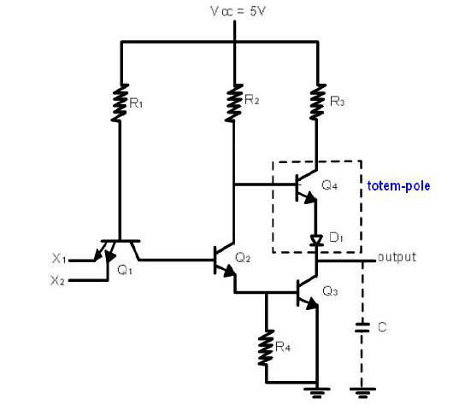
2 Input TTL NAND Gate with Active Pull up /Totem Pole output

Slide 39
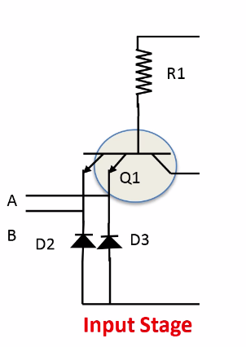
Internal Schematic of TTL Logic Gate
Input Stage:
In the I/P stage, it consist of a transistor which is multi emitter
2 I/Ps A & B can be applied here

Slide 40
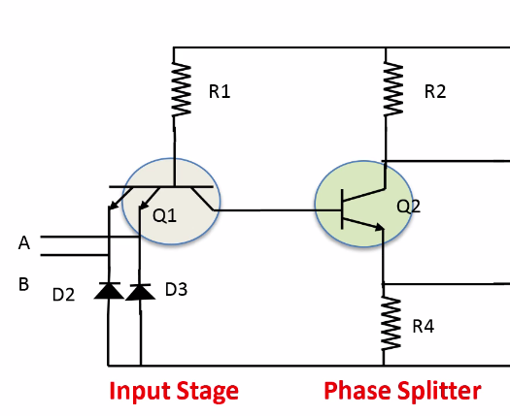
Internal Schematic of TTL Logic Gate (Contd..)
Phase Splitter:
The transistor is used as a switch & splits the phase into 2 parts (0 & 1)

Slide 41
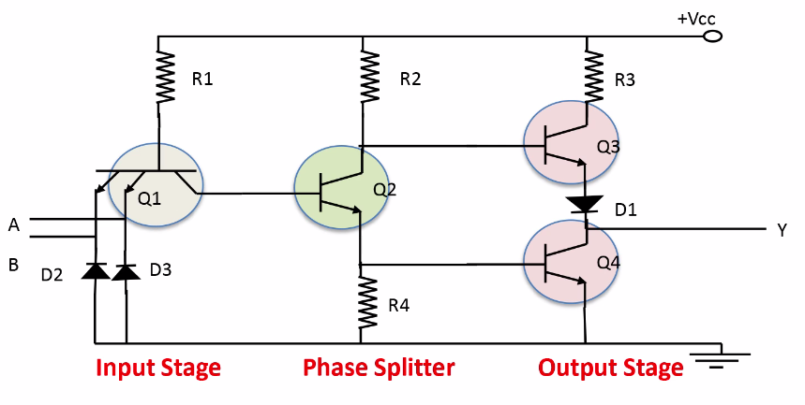
Internal Schematic of TTL Logic Gate (Contd..)
Output Stage:
It consist of 2 transistors, upper and lower.
Both transistors are not on at a time

Slide 42
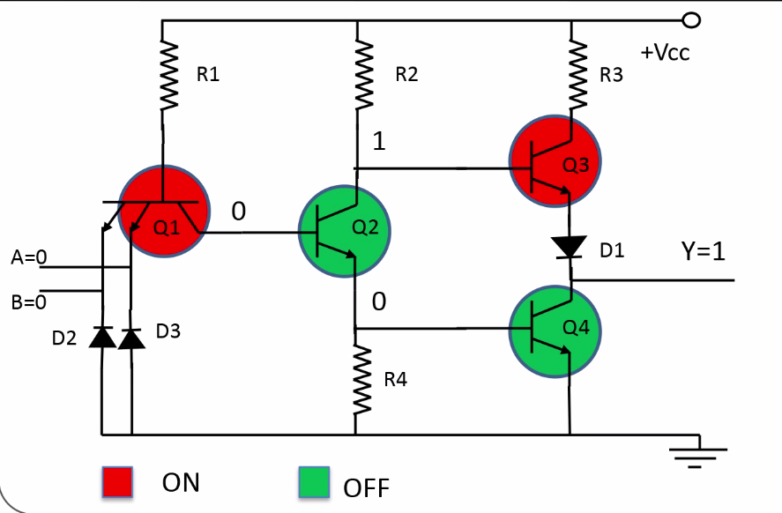
Working of TTL NAND Gate

Slide 43
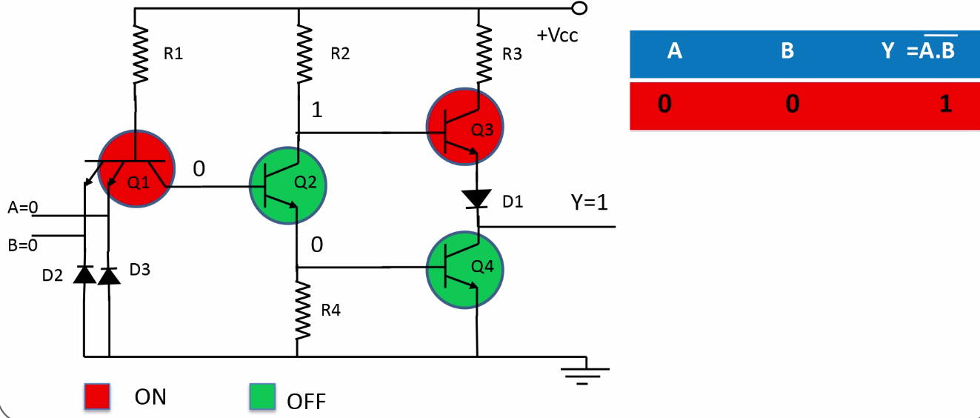
Working of TTL NAND Gate (Contd..)

Slide 44
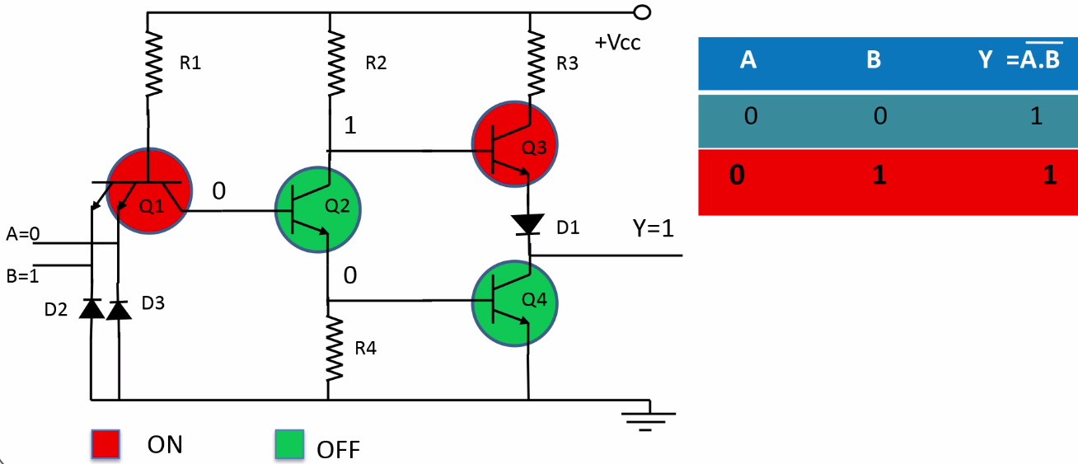
Working of TTL NAND Gate (Contd..)

Slide 45
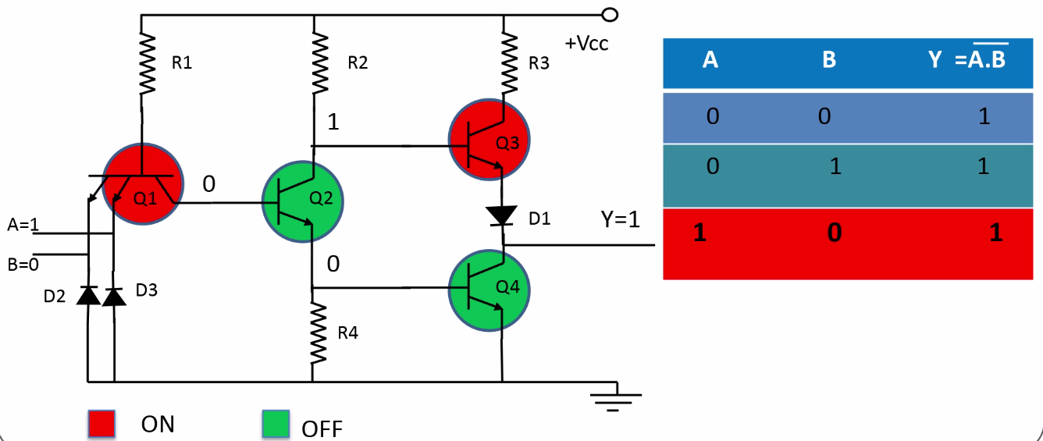
Working of TTL NAND Gate (Contd..)

Slide 46
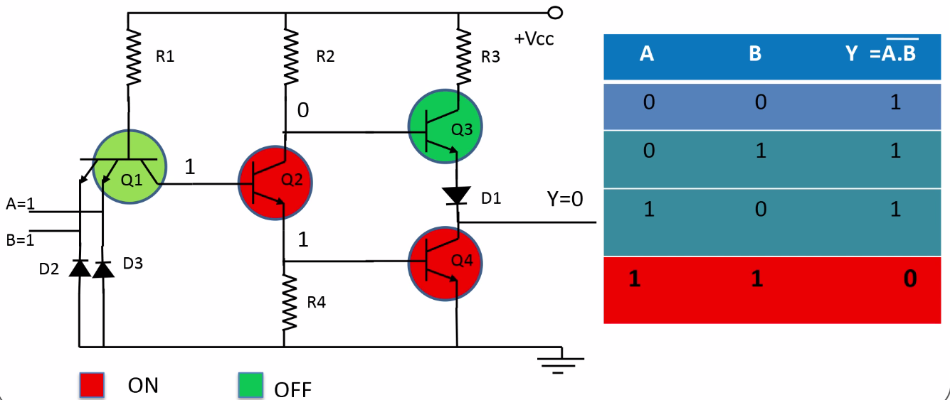
Working of TTL NAND Gate (Contd..)

Slide 47
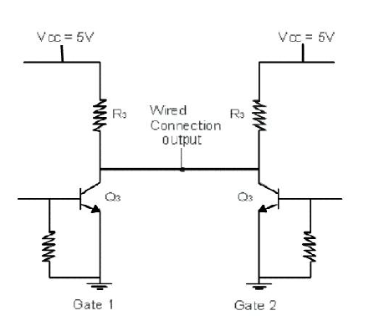
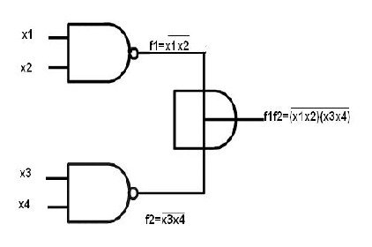
Wired Logic

Slide 48
Totem Pole TTL
Wired ANDing is not supported due to issues of sourcing current and Sinking Current

Slide 49
TTL – Transistor Transistor Logic
Saturated Logic Family …..(Saturation/Cutoff)
Standard TTL………(First Version)
TTL with Passive pullup
TTL with Totem Pole output
TTL with open collector output
Tristate TTL
Newer TTL families still used (74AL00 …)
Distinct Features: Multi Emitter Transistors

Slide 50
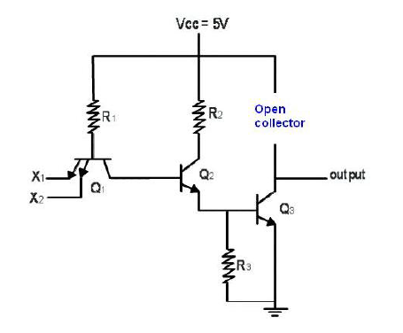
Open Collector TTL

Slide 51
Open Collector TTL
Collector of Transistor Q3 can not be left open.
A resistor can be used as pull up. It behaves as passive pull up TTL.
Benefits of Active pull up are vanished.

Slide 52
TTL – Transistor Transistor Logic
Saturated Logic Family …..(Saturation/Cutoff)
Standard TTL………(First Version)
TTL with Passive pullup
TTL with Totem Pole output
TTL with open collector output
Tristate TTL
Newer TTL families still used (74AL00 …)
Distinct Features: Multi Emitter Transistors

Slide 53
Tristate Output Configuration
There are 3 possible states:
Logic “1” State
Logic “0” State
High Impedance State
Controlled by external ENABLE input

Slide 54
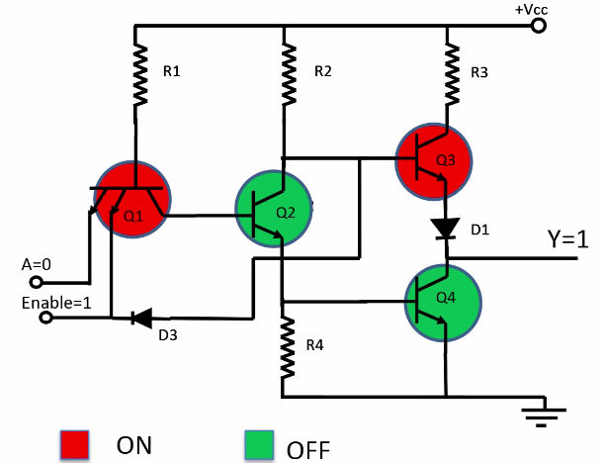
Tristate Output Configuration: TTL Inverter

Slide 55
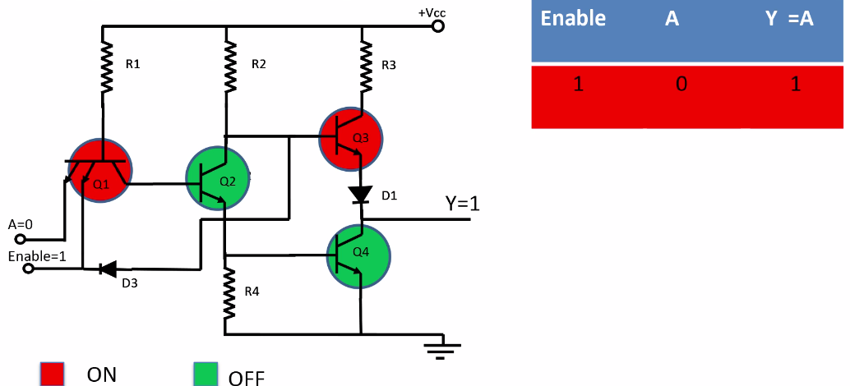
Tristate Output Configuration: TTL Inverter (Contd..)

Slide 56
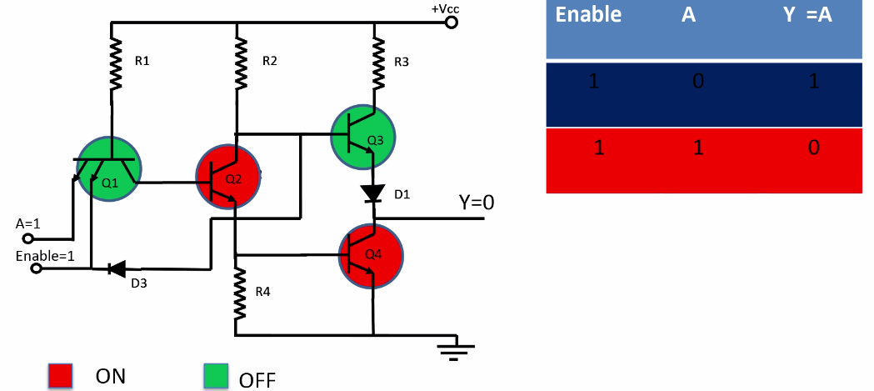
Tristate Output Configuration: TTL Inverter (Contd..)

Slide 57
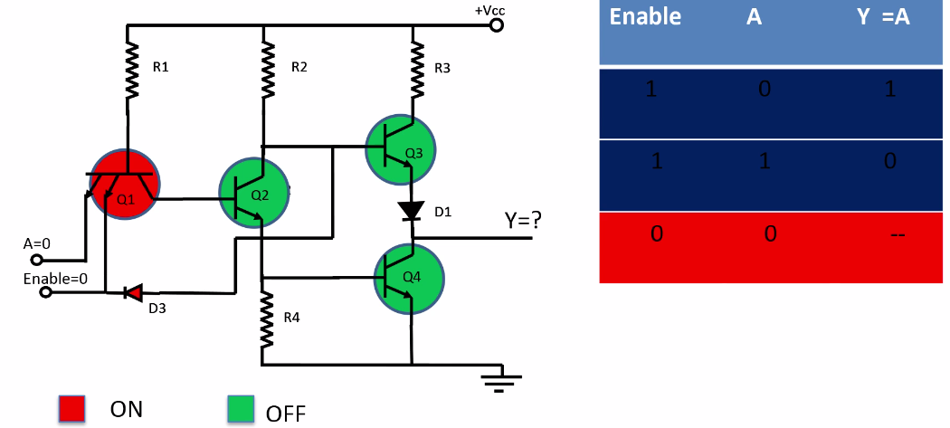
Tristate Output Configuration: TTL Inverter (Contd..)

Slide 58
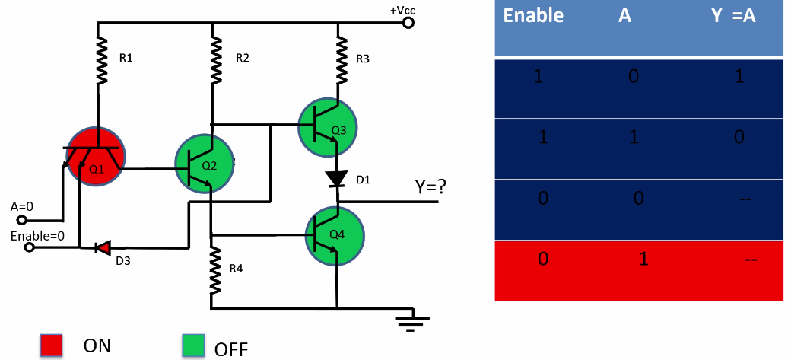
Tristate Output Configuration: TTL Inverter (Contd..)

Slide 59
TTL Subfamilies
TTL
Low Power Schottky TTL
Standard TTL
Low Power TTL
High Speed TTL
Schottky TTL

Slide 60
TTL Subfamilies (Contd..)
Standard TTL:
It uses resistor
Low power dissipation
Propagation delay largely depends on
Storage Time
RC Time Constant
Low Power TTL:
Resistor values used are generally higher than that used in standard TTL
Reduces power dissipation but increases propagation delay

Slide 61
TTL Subfamilies (Contd..)
High Speed TTL:
Low resistor values are used
Reduces propagation delay
Increases power dissipation
Schottky TTL:
Non Saturating Bipolar logic is used
Removes the storage time of transistor by preventing them from going into saturation
Low Power Schottky TTL:
Sacrifices some speed
It has reduced power dissipation

Slide 62
Schottky TTL
Schottky transistor is a combination of a transistor and schottky diode
It is also called as a Schottky Clamped Transistor
(A) Symbol for Schottky Transistor
(B) A Schottky Diode connected
to prevent transistor saturation

Slide 63
Schottky TTL (Contd..)
When the transistor is in the active region, diode D is Reverse-Biased
The diode conducts, when the base collector junction voltage falls to about 0.4 V & does not allow the collector voltage to fall lower than 0.4 V below the base voltage
Hence the collector junction is not sufficiently Forward-Biased & transistor is thus prevented from entering into saturation & hence there is saving in turn OFF time
Schottky TTL gates have propagation delay time of the order of 2 ns
It is a non saturating bipolar logic

Slide 64
Current Sink Logic
Current Sinking & sourcing is the term used in digital electronics to refer to the direction of direct current (DC) flow between Transistor – Transistor Logic (TTL) gates
It refers to the flow of conventional current from the positive (which is the sourcing end) to the ground (which is the sinking end)
Sinking: Provides a path to supply common (-)
Sourcing: Provides a path to supply source (+)
When all the I/Ps are High, the emitter base junction of T1 are Reverse-Biased
Therefore current drawn from the I/p source is the reverse saturation current of a p-n junction which is very small.

Slide 65
MOSFET Logic Family
NMOS
PMOS
CMOS

Slide 66
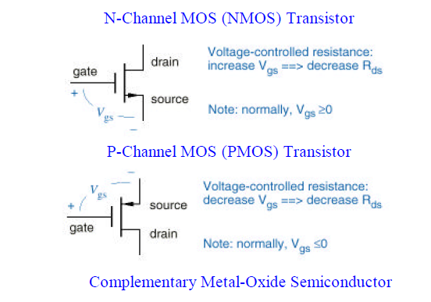
NMOS and PMOS FETs

Slide 67
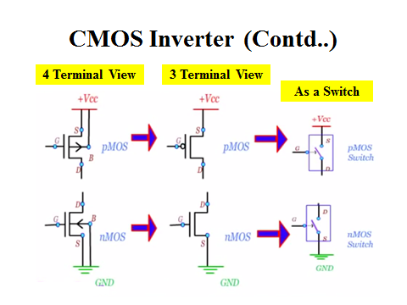
nMOS, pMOS symbols….

Slide 68
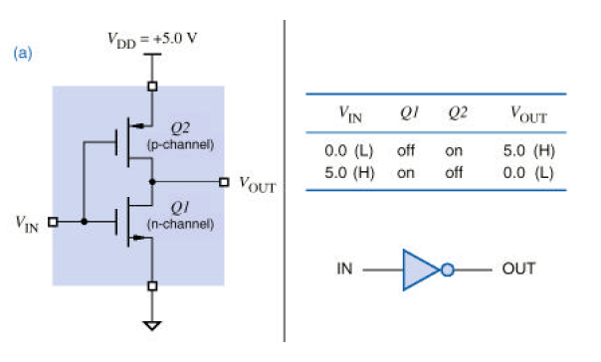
CMOS Inverter

Slide 69
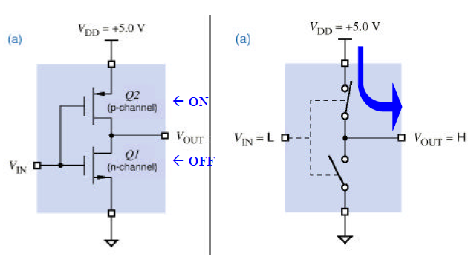
CMOS Inverter – Low Input

Slide 70
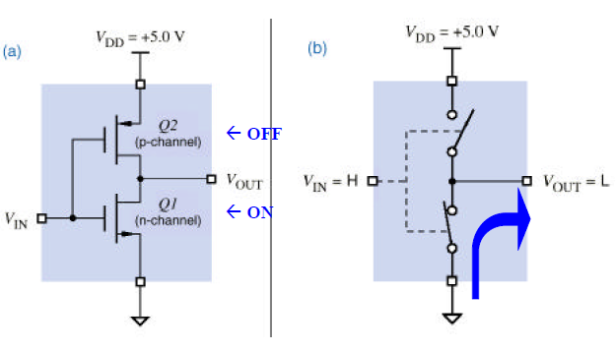
CMOS Inverter – High Input

Slide 71
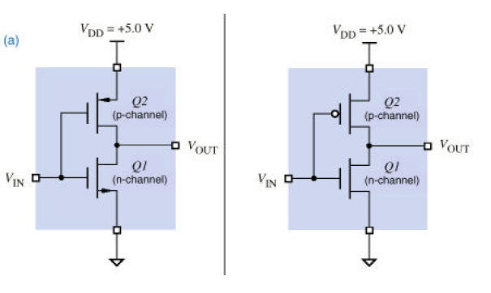
CMOS Inverter

Slide 72
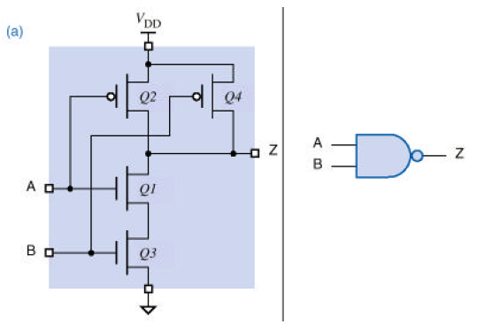
CMOS NAND

Slide 73
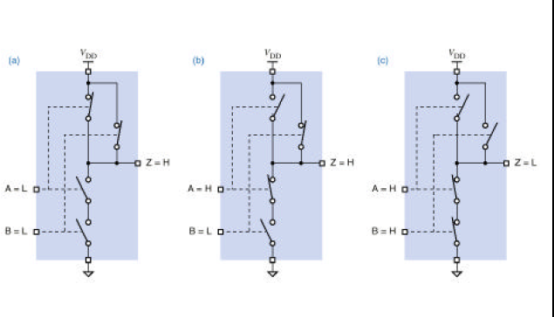
CMOS NAND – Input Combinations

Slide 74
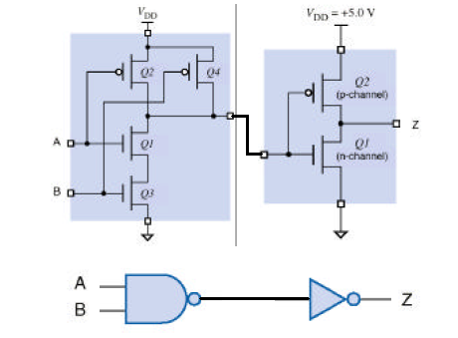
Making an AND GATE

Slide 75
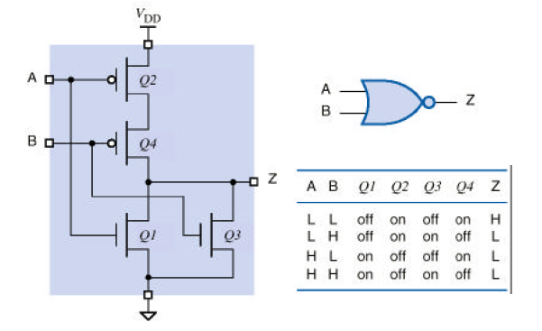
CMOS NOR

Slide 76
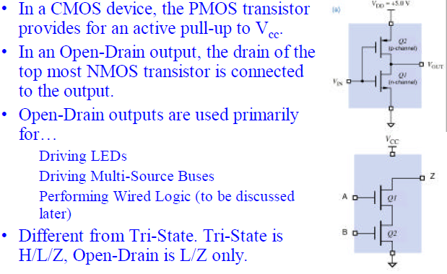
Open Drain Outputs

Slide 77
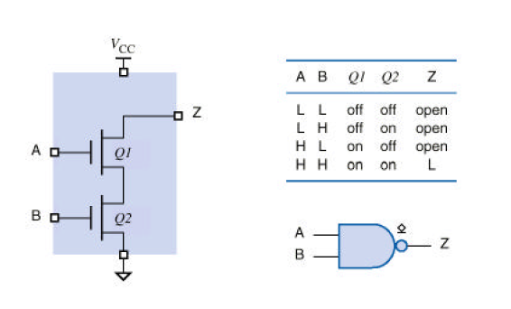
Open Drain NAND

Slide 78
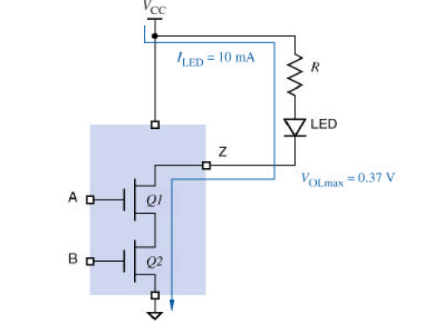
Open Drain Output – Driving LED

Slide 79
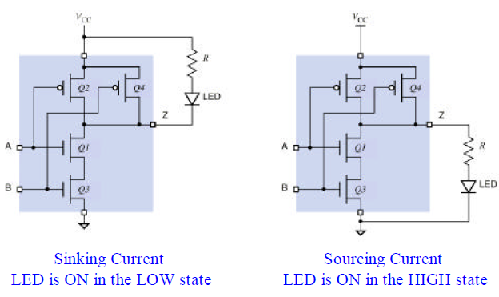
Standard CMOS driving LED

Slide 80
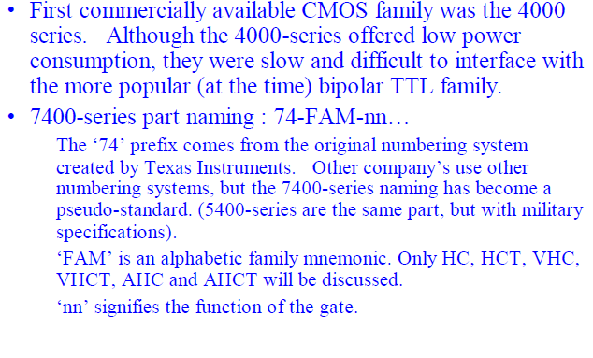
CMOS Logic Family

Slide 81
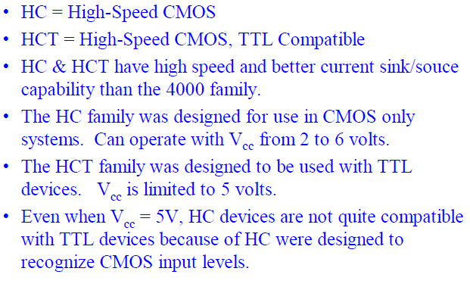
HC and HCT Facts

Slide 82

VHC and VHCT facts

Slide 83

Interfacing CMOS and TTL

Slide 84

TTL to CMOS

Slide 85
TTL Driving CMOS Voltage and Current specifications
Compare output capabilities of driver and input requirements of load
TTL driving CMOS in High State
VOH (TTL) > VIH (CMOS)----This requirement is not satisfied sometimes so pull up resister and buffers are required in between
IOH (TTL) > IIH (CMOS)
TTL driving CMOS in Low State
VOL (TTL) < VIL (CMOS)
IOL (TTL) > IIL (CMOS)
TTL | CMOS
VOH (Min) = 2.4 V | VIH (Min) = 3.5 V
VOL (Max) = 0.4 V | VIL (Max) = 1.5 V
IOH (Min) = 0.4 mA | IIH (Min) = 1 uA
IOL (Max) =16 mA | IIL (Max) = 1 uA

Slide 86

TTL to CMOS

Slide 87

CMOS to TTL

Slide 88
CMOS Driving TTL Voltage and Current specifications
Compare output capabilities of driver and input requirements of load
CMOS driving TTL in High State
VOH (CMOS) > VIH (TTL)
IOH (CMOS) > IIH (TTL)
CMOS driving TTL in Low State
VOL (CMOS) < VIL (TTL)
IOL (CMOS) > IIL (TTL)---------This requirement is not satisfied so buffers are required in between
CMOS (4000B) | TTL
VOH (Min) = 4.95 V | VIH (Min) = 2.0 V
VOL (Max) = 0.05 V | VIL (Max) = 0.8 V
IOH (Min) = 0.4 mA | IIH (Min) = 40 uA
IOL (Max) = 0.4 mA | IIL (Max) = 1.6 mA

Slide 89

CMOS to TTL

Slide 90
Comparison of CMOS and TTL
Parameter | TTL | CMOS
Basic Gate | NAND | NAND or NOR
Fan Out | 10 | >50
Power Dissipation (Per Gate in mw) | 12-22 | 0.01 Static, 1 at 1MHZ
Noise immunity | Very Good | Very Good
Propagation Delay (Per Gate in ns) | 12-6 | 70
Clock Rate, MHZ | 15-60 | 5
No. of Functions | Very High | low

Slide 91


